Slide 1
Partial Orderings

Slide 2
Introduction
An equivalence relation is a relation that is reflexive, symmetric, and transitive
A partial ordering (or partial order) is a relation that is reflexive, antisymmetric, and transitive
  Recall that antisymmetric means that if (a,b) ∈ R, then (b,a) ∉ R unless b = a
  Thus, (a,a) is allowed to be in R
  But since it’s reflexive, all possible (a,a) must be in R

Slide 3
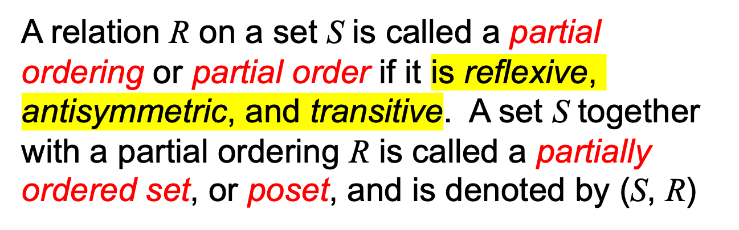
Partially Ordered Set (POSET)

Slide 4
Example (1)
Let S = {1, 2, 3} and
let R = {(1,1), (2,2), (3,3), (1, 2), (3,1), (3,2)}
1
2
3

Slide 5


In a poset the notation a b denotes that
This notation is used because the “less than or equal to” relation is a paradigm for a partial ordering. (Note that the symbol is used to denote the relation in any poset, not just the “less than or equals” relation.) The notation a b denotes that
a b, but

Slide 6
Example
Let S = {1, 2, 3} and
let R = {(1,1), (2,2), (3,3), (1, 2), (3,1), (3,2)}
2 2
3 2
1
2
3

Slide 7
Example (2)
Show that ≥ is a partial order on the set of integers
  It is reflexive: a ≥ a for all a ∈ Z
  It is antisymmetric: if a ≥ b then the only way that
  b ≥ a is when b = a
  It is transitive: if a ≥ b and b ≥ c, then a ≥ c
Note that ≥ is the partial ordering on the set of integers
(Z, ≥) is the partially ordered set, or poset

Slide 8

Example (3)
Consider the power set of {a, b, c} and the subset relation. (P({a,b,c}), )
Draw a graph of this relation.

Slide 9
Comparable / Incomparable
The elements a and b of a poset (S, ) are called comparable if either a b or b a. When a and b are elements of S such that neither a b nor b a, a and b are called incomparable.

Slide 10
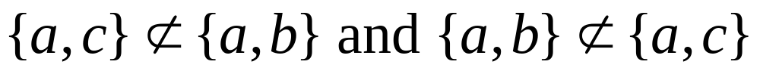
Example
Consider the power set of {a, b, c} and the subset relation. (P({a,b,c}), )
So, {a,c} and {a,b} are incomparable

Slide 11
Totally Ordered, Chains
(S, )
If is a poset and every two elements of S are comparable, S is called totally ordered or linearly ordered set, and is called a total order or a linear order. A totally ordered set is also called a chain.

Slide 12
In the poset (Z⁺,≤), are the integers 3 and 9 comparable?
  Yes, as 3 ≤ 9
Are 7 and 5 comparable?
  Yes, as 5 ≤ 7
As all pairs of elements in Z⁺ are comparable, the poset (Z⁺,≤) is a total order
  a.k.a. totally ordered poset, linear order, or chain

Slide 13
In the poset (Z⁺,|) with “divides” operator |, are the integers 3 and 9 comparable?
  Yes, as 3 | 9
Are 7 and 5 comparable?
  No, as 7 | 5 and 5 | 7
Thus, as there are pairs of elements in Z⁺ that are not comparable, the poset (Z⁺,|) is a partial order. It is not a chain.

Slide 14
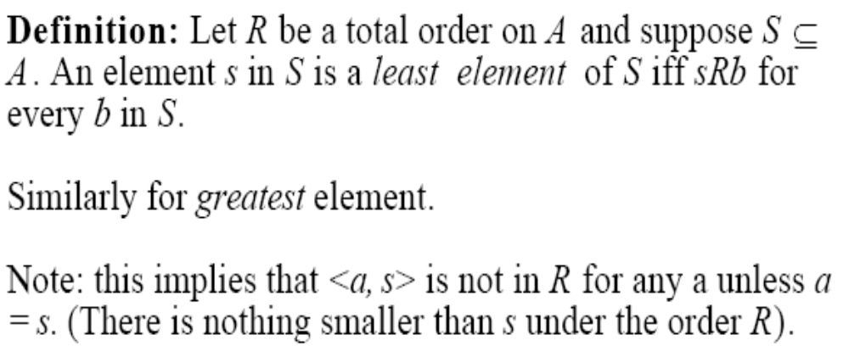

Slide 15
Well-Ordered Set
(S, )
is a well-ordered set if it is a poset such that is a total ordering and such that every nonempty subset of S has a least element.
Example: Consider the ordered pairs of positive integers, Z⁺ x Z⁺ where

Slide 16
Well-ordered sets examples
Example: (Z,≤)
  Is a total ordered poset (every element is comparable to every other element)
  It has no least element
  Thus, it is not a well-ordered set
Example: (S,≤) where S = { 1, 2, 3, 4, 5 }
  Is a total ordered poset (every element is comparable to every other element)
  Has a least element (1)
  Thus, it is a well-ordered set

Slide 17
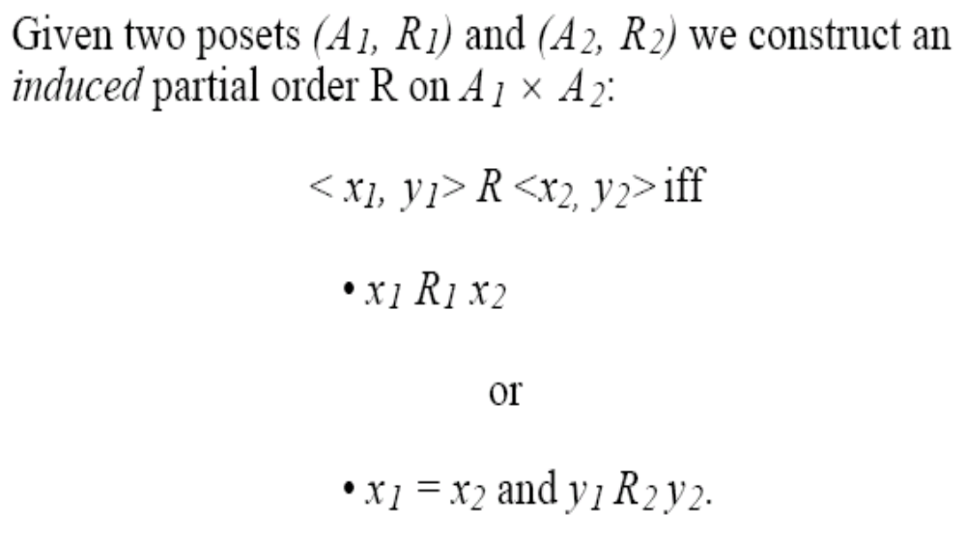
Lexicographic Order
This ordering is called lexicographic because it is the way that words are ordered in the dictionary.

Slide 18
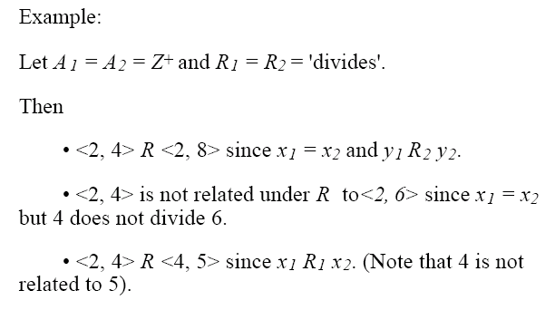

Slide 19
Hasse Diagrams
Given any partial order relation defined on a finite set, it is possible to draw the directed graph so that all of these properties are satisfied.
This makes it possible to associate a somewhat simpler graph, called a Hasse diagram, with a partial order relation defined on a finite set.

Slide 20
Hasse Diagrams (continued)
Start with a directed graph of the relation in which all arrows point upward. Then eliminate:
the loops at all the vertices,
all arrows whose existence is implied by the transitive property,
the direction indicators on the arrows.

Slide 21
Example
Let A = {1, 2, 3, 9, 18} and consider the “divides” relation on A:
For all
18
9
2
3
1

Slide 22
Example
Eliminate the loops at all the vertices.
Eliminate all arrows whose existence is implied by the transitive property.
Eliminate the direction indicators on the arrows.
18
9
2
3
1

Slide 23
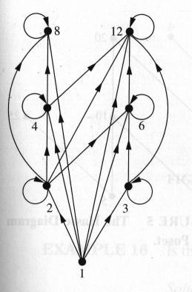
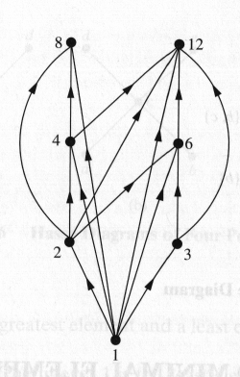
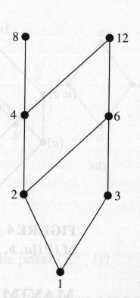
Hasse Diagram
For the poset ({1,2,3,4,6,8,12}, |)

Slide 24
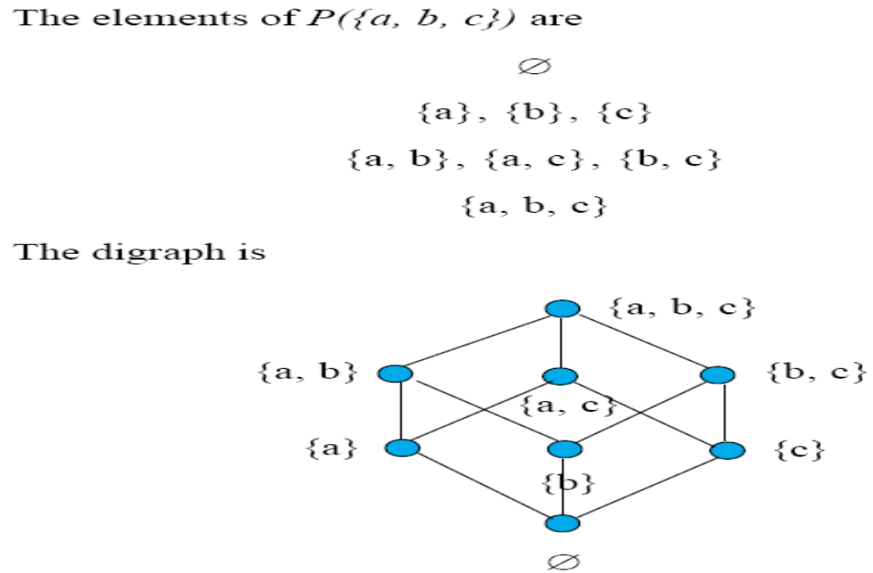

Slide 25
Before this

Slide 26


Maximal and Minimal Elements
a is a maximal in the poset (S, ) if there is no
such that a b. Similarly, an element of a poset is called minimal if it is not greater than any element of the poset. That is, a is minimal if there is no element
such that b a.
It is possible to have
multiple minimals and maximals.

Slide 27
Greatest Element
Least Element
a is the greatest element in the poset (S, ) if b a
for all . Similarly, an element of a poset is called the least element if it is less or equal than all other elements in the poset. That is, a is the least element if
a b for all

Slide 28

Upper bound, Lower bound
Sometimes it is possible to find an element that is greater than all the elements in a subset A of a poset (S, ). If u is an element of S such that a u for all elements , then u is called an upper bound of A. Likewise, there may be an element less than all the elements in A. If l is an element of S such that l a for all elements , then l is called a lower bound of A.
Examples 18, p. 574 in Rosen.

Slide 29
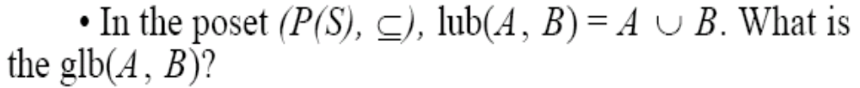
Least Upper Bound,
Greatest Lower Bound
The element x is called the least upper bound (lub) of the subset A if x is an upper bound that is less than every other upper bound of A.
The element y is called the greatest lower bound (glb) of A if y is a lower bound of A and z y whenever z is a lower bound of A.
Examples 19 and 20, p. 574 in Rosen.

Slide 30
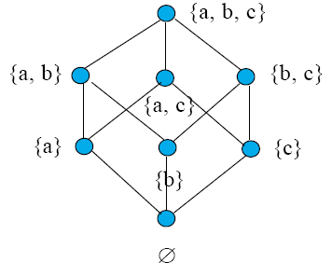

Lattices
A partially ordered set in which every pair of elements has both a least upper bound and a greatest lower bound is called a lattice.

Slide 31
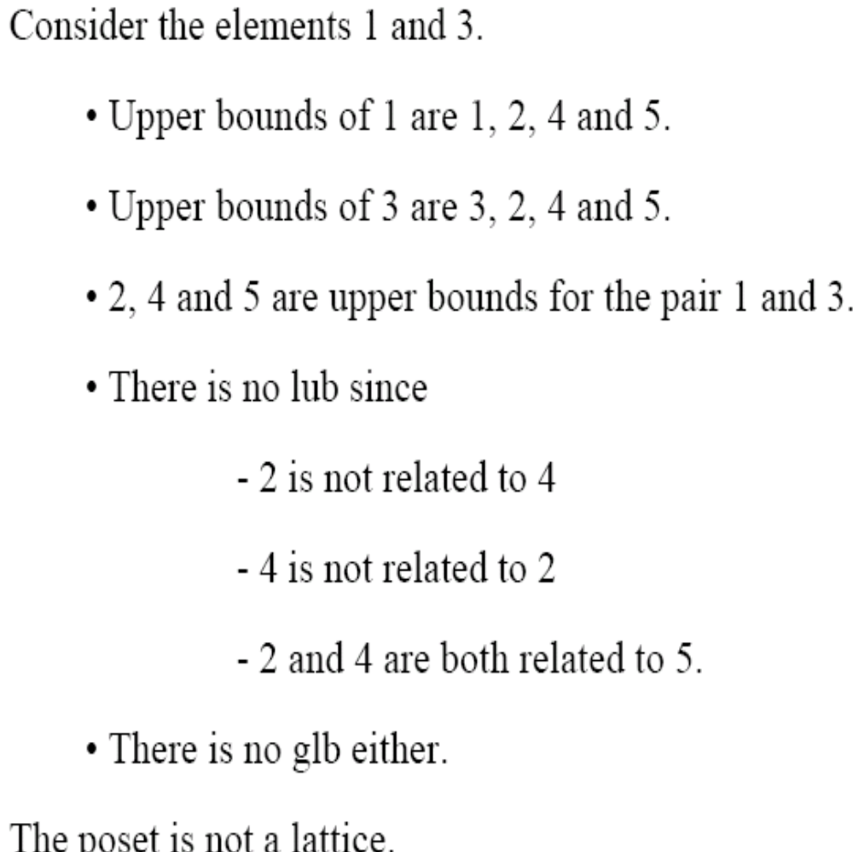
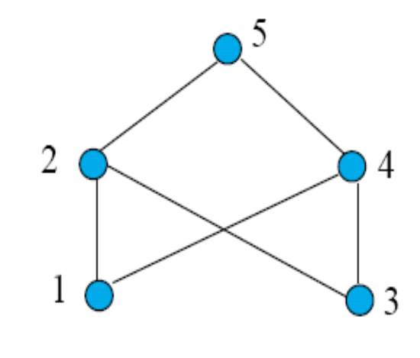
Examples 21 and 22, p. 575 in Rosen.

Slide 32

Example
Consider the set A = {2, 3, 4, 6, 18, 24} ordered by the “divides” relation. The Hasse diagram follows:
24
18
4
6
2
3
The ordinary “less than or equal to” relation on this set is a topological sorting for it since for positive integers a and b, if a|b then a b.

